Slide 1

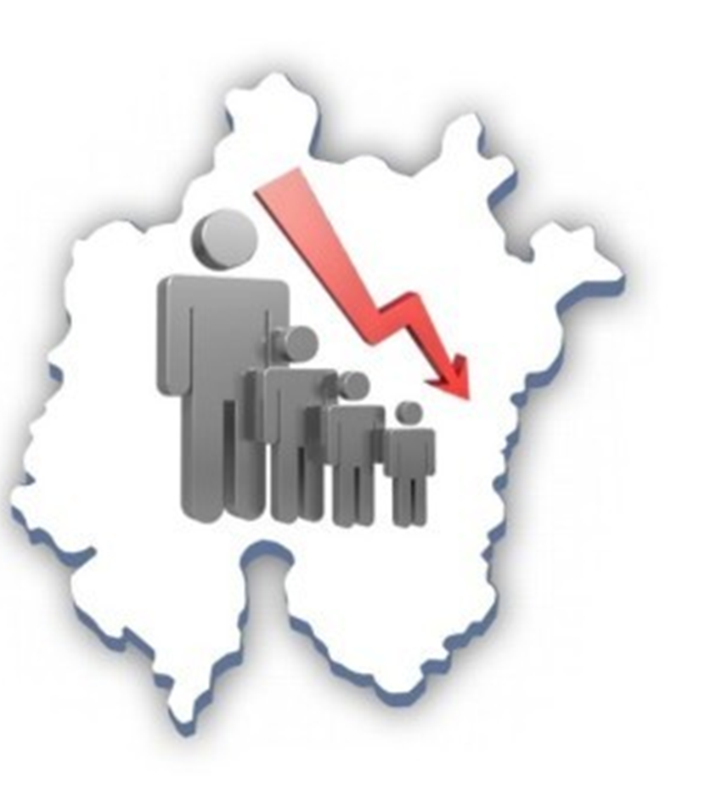
South Korea’s
Birth rate crisis
By Hyewon Jeong, Yujin Bong

Slide 2
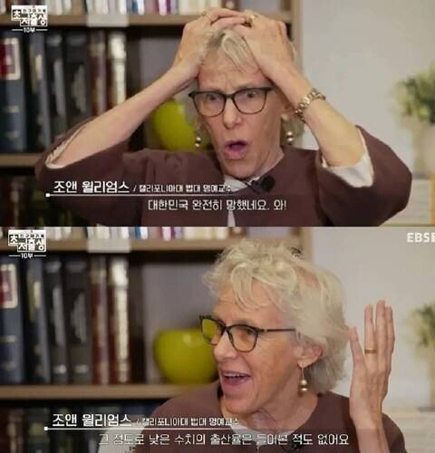
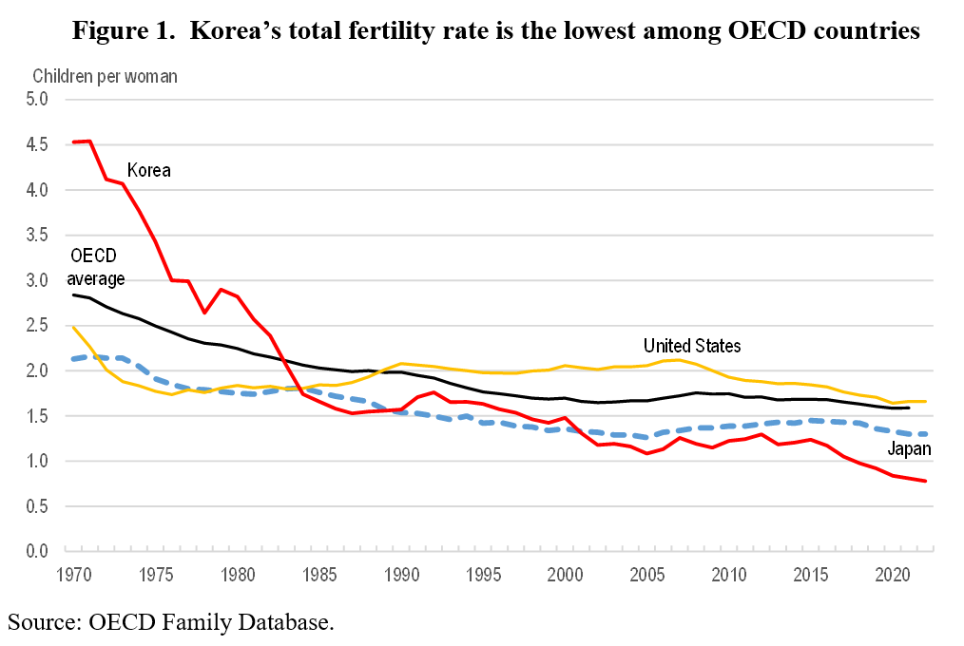
Is Korea ruined?
0.778!
Joanne Williams | Professor Emeritus at California Law School
Korea is completely ruined. Wow!
Joanne Williams | Professor Emeritus at California Law School
I've never heard of a birth rate that low.
Notes:
혜

Slide 3
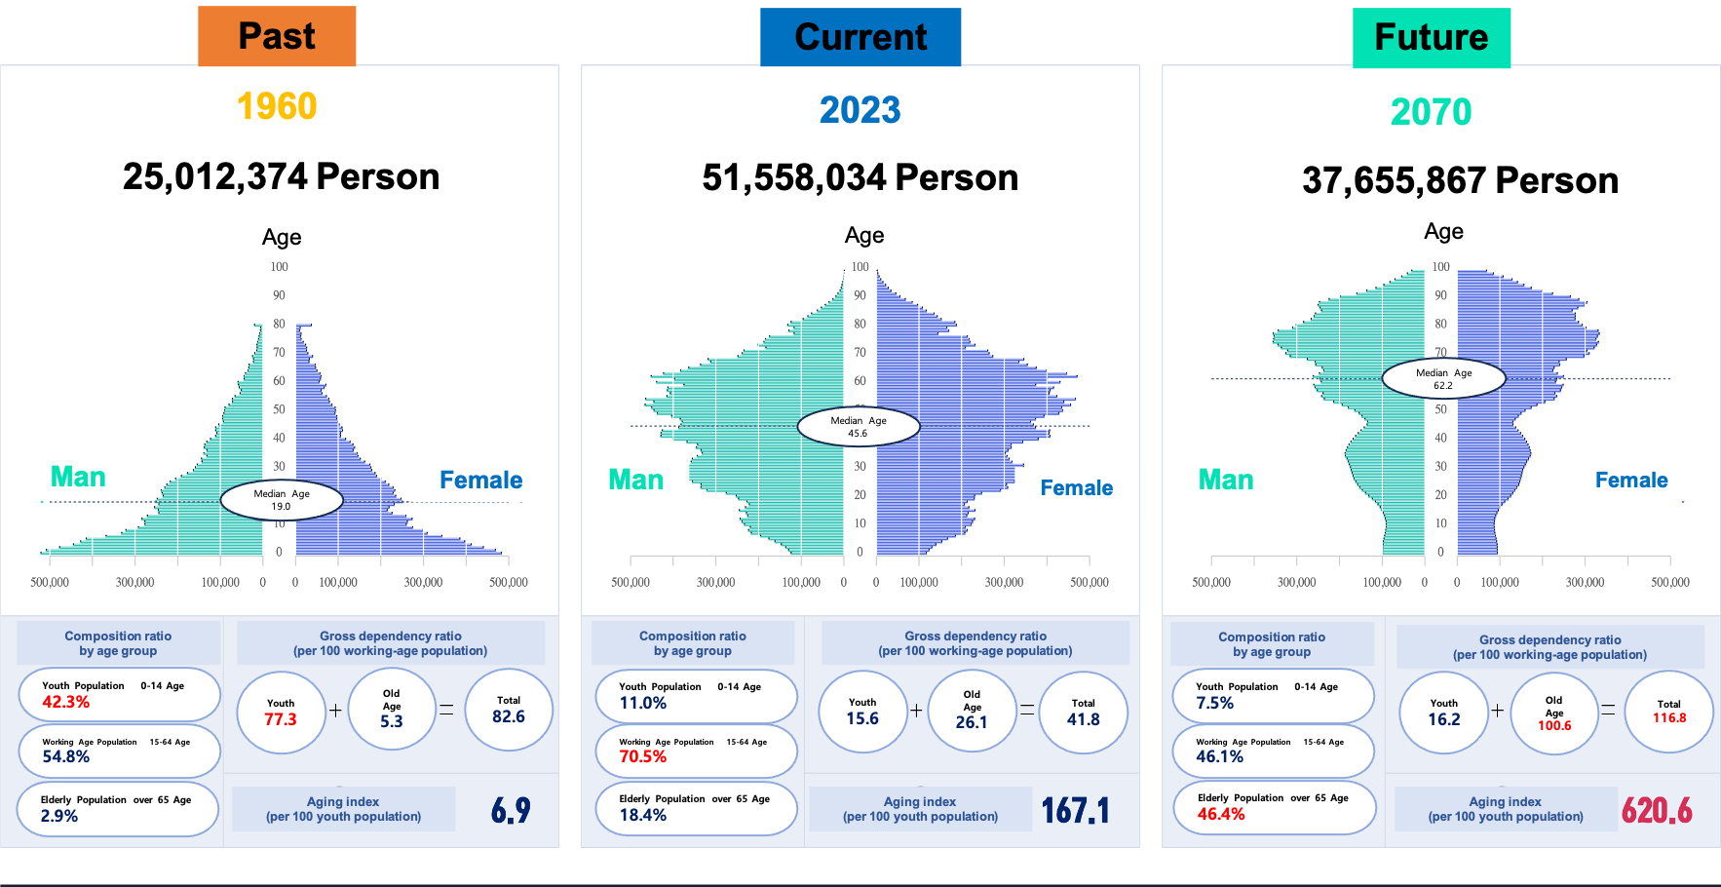
Notes:
혜

Slide 4

Derived Problems from Birth Rate Decreasing
Pension Problems
The pension issue is a global issue,
just as the French pension reform has become a global issue.
In Korea, the pension issue due to the declining birth rate was also discussed.
Notes:
혜

Slide 5

Derived Problems from Birth Rate Decreasing
2) Tax Burden Rate
Total national Tax Income
Tax Burden Rate
Notes:
혜

Slide 6
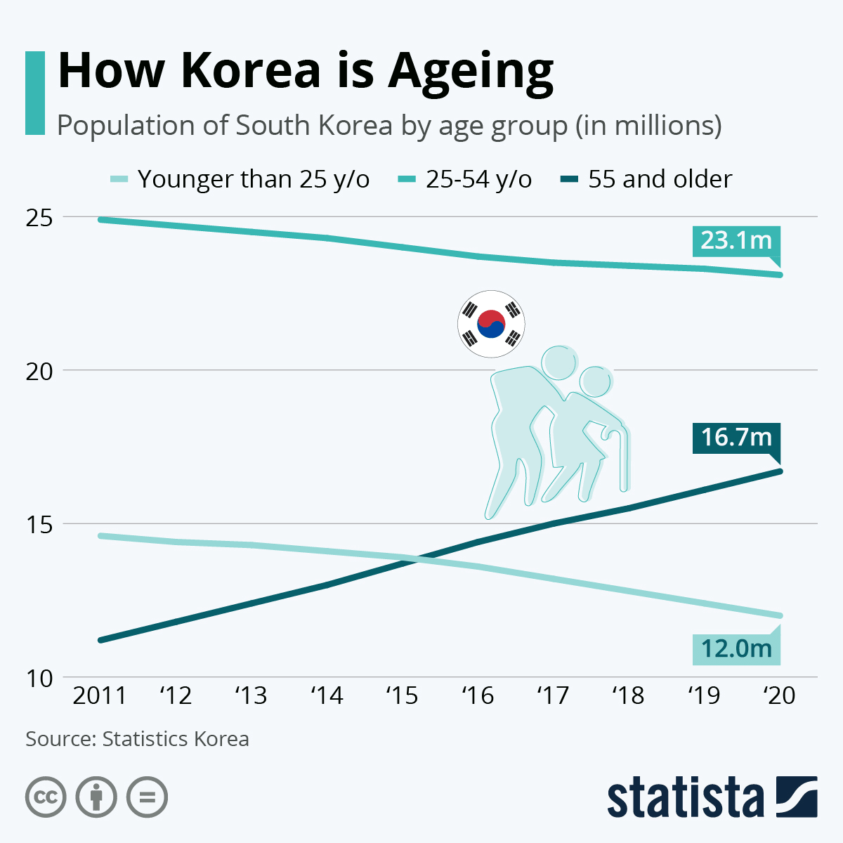
Derived Problems from Birth Rate Decreasing
3) Aging Problem
Notes:
유

Slide 7
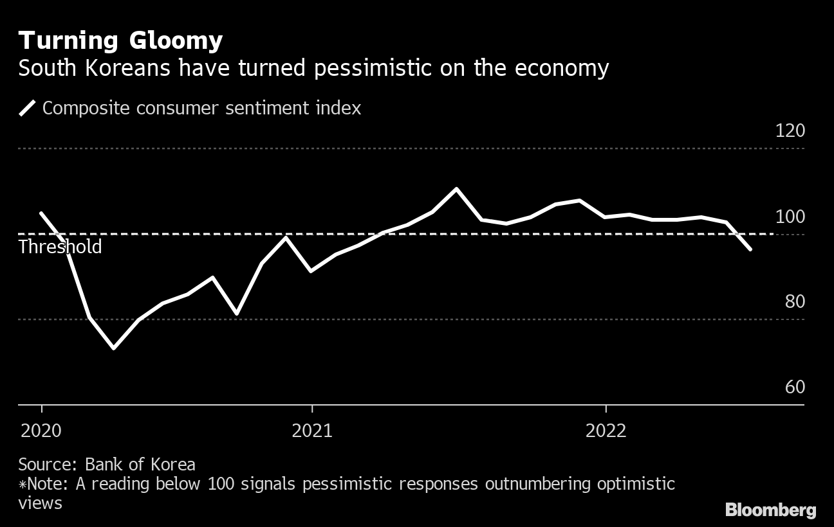
Derived Problems from Birth Rate Decreasing (Coun’t)
4) Deterioration of Economies
Notes:
유

Slide 8

Derived Problems from Birth Rate Decreasing
5) Weakening of national defense
In Korea, which has a conscription system, a decline in the birth rate causes a decline in the number of enlisted men, weakening military power.
Notes:
유

Slide 9

Causes of declining Birth Rate
This year's Nobel Prize winner in economics speaks
Social structural changes caused by rapid economic growth
Notes:
혜

Slide 10
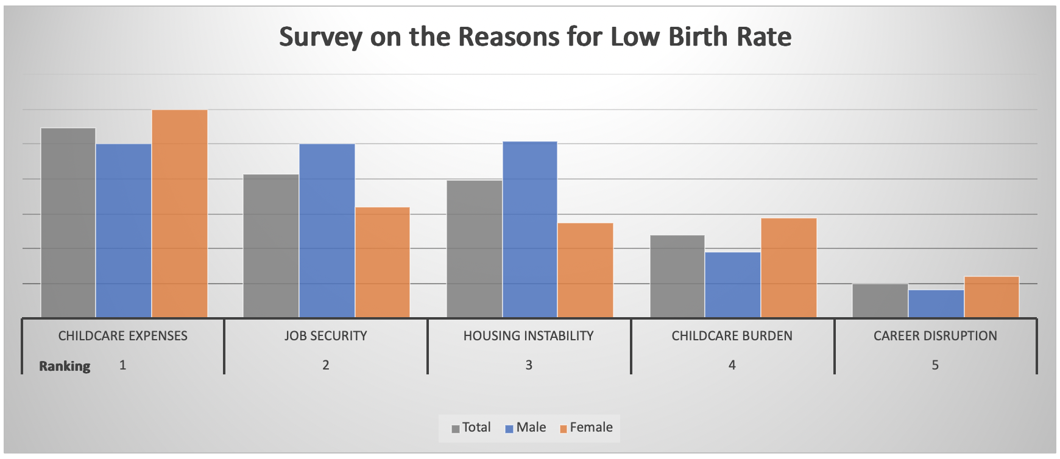
Causes of declining Birth Rate
2) Survey says reasons for not giving birth
Notes:
혜

Slide 11
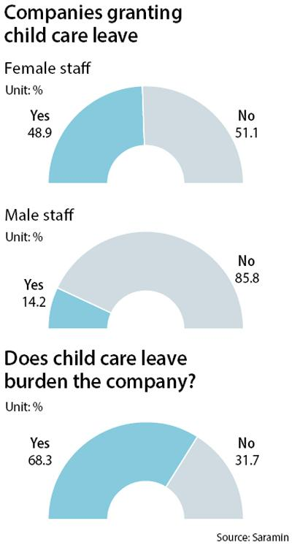
Causes of declining Birth Rate
3) Childcare burden concentrated on women
This phenomenon causes women to take a break in their careers, which is why women avoid childbirth.
Notes:
혜

Slide 12


Slide 13


-Expansion of the nation’s public childcare facilities
- Implementing Corporate Maternity Welfare Policies

Slide 14
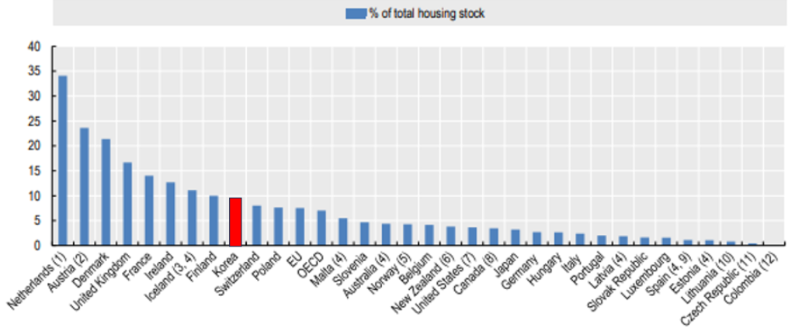
Number of Public Housing

Slide 15
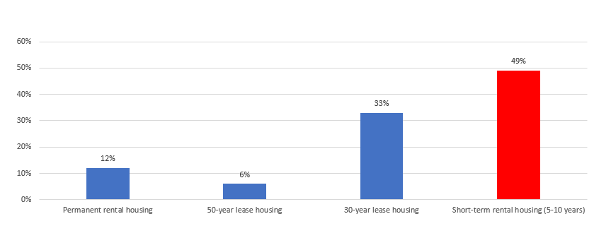
Duration of Public Housing Tenure in Korea

Slide 16
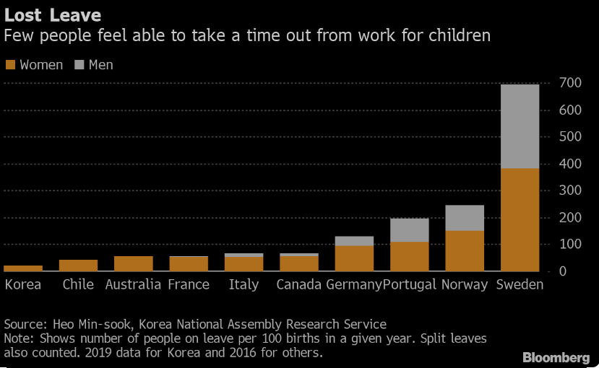
Notes:
:https://www.bloomberg.com/news/articles/2022-09-13/burden-of-raising-kids-drives-korean-fertility-to-world-s-lowest?embedded-checkout=true

Slide 17
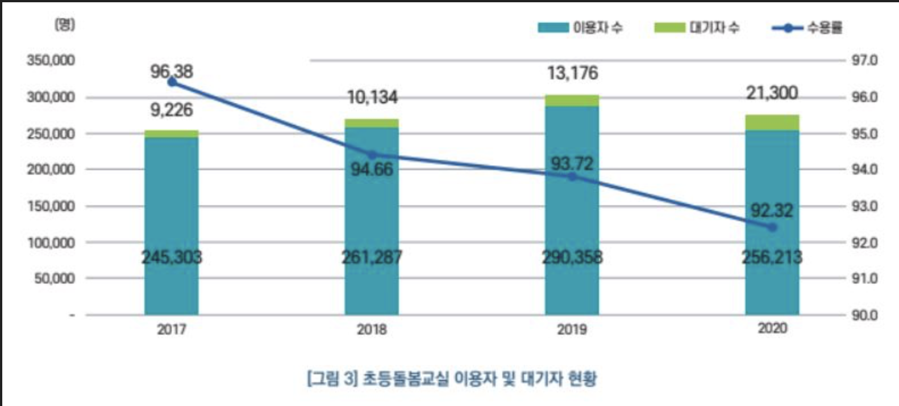
Child Care Center Status
Number Of People
Users
Waiting
Capacity Rate
child care center users and waiting status

Slide 18
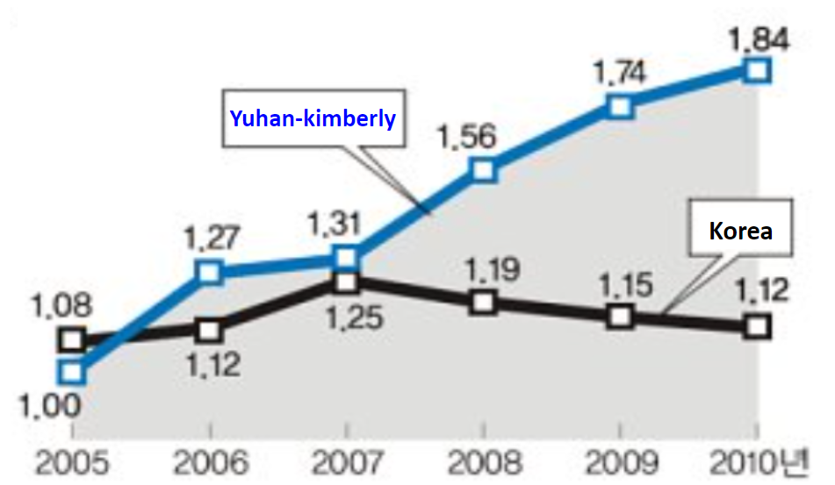


Case Of Increasing Fertility Rate
Notes:
한국의 구직사이트 “사람인”에 따르면, 한국의 직장인 10명중 7명은 회사복지에 만족하지못한다고 밝혀졌다.
유한킴벌리의 사내 여직원의 출산합계출산율이 1.84명으로 높인사례가있는데 휴직기간 연장, 유연근무제 도입과 육아휴직 사용적극권장등
https://plating.blog/post/about/8748?ckattempt=1

Slide 19
References
OECD. (2019). PH4.2 SOCIAL RENTAL HOUSING STOCK from https://www.oecd.org/els/family/PH4-2-Social-rental-housing-stock.pdf
MOLIT(Ministry of Land, Infrastructure and Transport). National rental housing policy plan from https://www.molit.go.kr/USR/policyData/m_34681/dtl.jsp?search=&srch_dept_nm=&srch_dept_id=&srch_usr_nm=&srch_usr_titl=Y&srch_usr_ctnt=&search_regdate_s=&search_regdate_e=&psize=10&s_category=p_sec_2&p_category=201&lcmspage=7&id=571
Bloomberg. (2022). Burden of Raising Kids Drives Korean Fertility to World’s Lowest from https://www.bloomberg.com/news/articles/2022-09-13/burden-of-raising-kids-drives-korean-fertility-to-world-s-lowest?embedded-checkout=true

Slide 20


